Slide 1
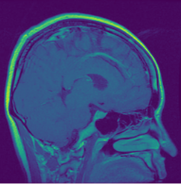
Enhancing Brain Tumor Diagnosis with MRI and Neural Networks
Chelsea Berry
Capstone Project August 2024

Slide 2
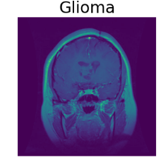
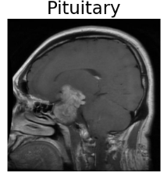
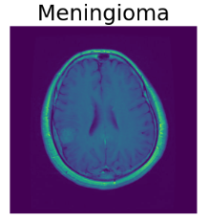
Introduction
Brain Tumors
Abnormal growths within the brain or central spinal canal
Importance of Timely Detection
Vital for effective treatment
Improved patient outcomes
Common Types of Brain Tumors
Notes:
Context: Brain tumors, are abnormal growths of cells within the brain or the central spinal canal. These tumors can be either benign, meaning non-cancerous, or malignant, which are cancerous. Despite the differences in their nature, both types can have serious implications on an individual's health and require immediate medical attention.
The key to effective treatment and improved patient outcomes lies in the timely and accurate detection of these tumors. Early detection is crucial as it allows for interventions at a stage where treatments can be most effective, potentially saving lives and improving the quality of life for patients.
We commonly encounter three types of brain tumors: gliomas, meningiomas, and pituitary tumors. Each of these has unique characteristics that influence their behavior, growth rate, and response to treatment. For instance, gliomas are known for their aggressive nature, while meningiomas and pituitary tumors might present differently and require different treatment approaches.

Slide 3
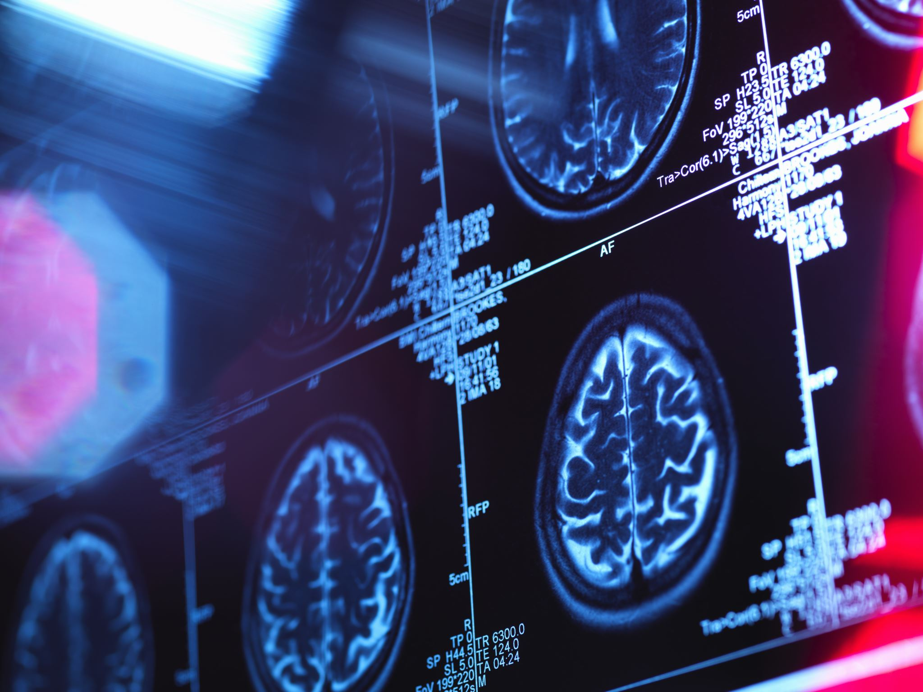
Project Focus
Enhancing diagnosis using MRI scans
Application of deep learning techniques
Development of a reliable and efficient tool for early detection and precise localization of tumors
Notes:
In this project, we have focused on applying advanced deep learning techniques to enhance the diagnosis of brain tumors using MRI scans. Our aim is to leverage the power of neural networks to develop a reliable and efficient tool for the medical community. This tool is designed to facilitate the early detection and precise localization of tumors, making it an invaluable asset in routine screenings and diagnostic procedures.
Throughout this presentation, we will walk through our methods, the results we achieved, and the implications of our findings. Our goal is to show how this approach can significantly improve the diagnostic process, ultimately leading to better patient outcomes.

Slide 4
Audience
Doctors and Radiologist
Hospitals and Medical Centers
Insurance Companies
Medical Researchers and Academics
Notes:
Doctors and Radiologists: These medical professionals are at the forefront of patient care and diagnosis. Implementing deep learning models in MRI analysis can significantly enhance their diagnostic accuracy and efficiency. This allows them to detect brain tumors at earlier stages and make more informed treatment decisions.
Hospitals and Medical Centers: Healthcare institutions can integrate these advanced diagnostic tools into their existing systems to streamline workflows, optimize resource allocation, and improve overall patient care. Automating MRI scan analysis can reduce the workload on radiologists and enable hospitals to serve more patients efficiently.
Insurance Companies: Insurance providers can benefit from the reduced costs associated with early diagnosis and treatment of brain tumors. Early detection prevents the progression of tumors to more advanced, costly stages. Additionally, improved diagnostic accuracy leads to fewer misdiagnoses and unnecessary treatments, optimizing healthcare costs.
Medical Researchers and Academics: Researchers can leverage the findings and methodologies presented in this report to advance the field of medical imaging and diagnostic AI. The data and results provide a foundation for future studies aimed at improving the accuracy and efficiency of tumor detection models.

Slide 5
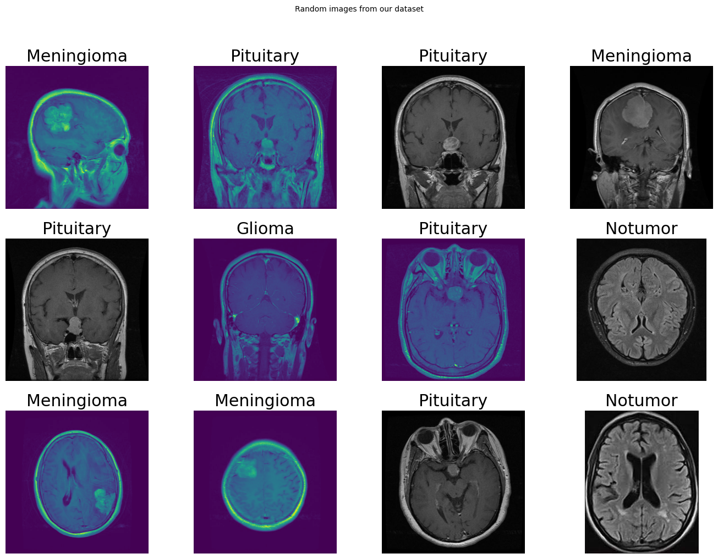
Data
From Kaggel.com
Categories:
Glioma: 1621
Meningioma: 1645
Pituitary Tumors: 1757
No Tumor: 2000
Notes:
Source: The dataset used for this project is sourced from Kaggle.com
Categories: The dataset is categorized into four classes: glioma, meningioma, no tumor, and pituitary tumors. Each category includes a diverse set of images, offering a broad representation of the different tumor types.
Visual Representation: These are random images taken from the dataset and you can see examples from each category. Each category includes a diverse set of images captured from different angles and perspectives, providing a comprehensive representation of the various tumor types and their characteristics.

Slide 6
Data Preprocessing
Blurred image removal
Normalization
Label Encoding
Data Splitting
Notes:
Blurred Image Removal: To ensure the highest quality input for our model, we first removed blurred images from the dataset. This was accomplished by calculating the variance of the Laplacian for each image. Images that fell below a certain threshold were classified as blurred and subsequently excluded. This step was crucial for enhancing the clarity and reliability of the data. We found 5 blurred images, due to the low number we just excluded them.
Normalization: We then normalized the images by scaling their pixel values to a range of 0 to 1. Normalization ensures that the model processes each image on the same scale, preventing any single pixel value from disproportionately affecting the training process.
Label Encoding: Next, we encoded the labels for the tumor types into numerical values, making them suitable for the classification task. This step is necessary for the model to understand and differentiate between the various tumor categories.
Data Split: Finally, we split the dataset into training and testing sets, with 80% of the data used for training and 20% reserved for testing. This split ensures that the model is trained on a substantial portion of the data while still being evaluated on a separate, unseen dataset to assess its performance.

Slide 7
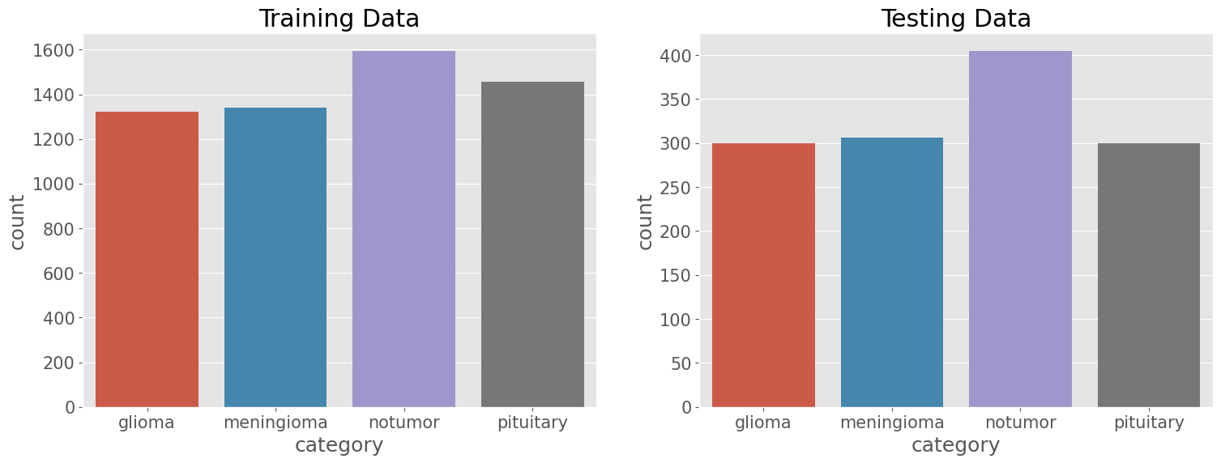
Training and Testing Sets
Notes:
Training and Testing Examples: The dataset is split into training and testing sets to evaluate the model's performance on unseen data. For training, we have 1321 images of gliomas, 1339 images of meningiomas, 1595 images of non-tumor brains, and 1457 images of pituitary tumors. For testing, the dataset includes 300 gliomas, 306 meningiomas, 405 non-tumor images, and 300 pituitary tumors. We can see that each category is evenly distributed across all categories in both the training and testing sets. This ensures that the model is well-trained and evaluated on a comprehensive set of images.

Slide 8
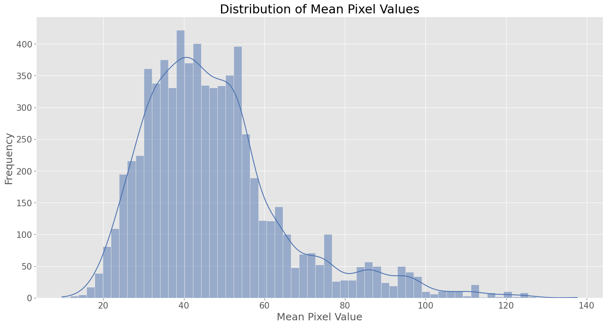
Exploratory Data Analysis (EDA)
Consistency in Color Format:
All MRI images confirmed to be in RGB format.
Standardized Image Size:
Images resized to 168x168 pixels for uniformity.
Mean Pixel Value Distribution:
Right-skewed distribution.
Majority of images have mean pixel values between 20 and 60.
Notes:
Consistency in Color Format:
In our exploratory data analysis, we confirmed that all MRI images were in RGB color format.
Standardized Image Size:
Each image was resized to a uniform dimension of 168x168 pixels. This standardization is necessary to ensure that all images are processed in the same way by the neural network, which helps in maintaining the integrity of the model's input data.
Mean Pixel Value Distribution:
The histogram shown on the slide illustrates the distribution of mean pixel values across our dataset. The distribution demonstrates a right-skewed shape, with most images having mean values between 20 and 60. This indicates that the majority of the images have relatively low average pixel intensities, which is characteristic of MRI scans due to their inherently dark backgrounds.
By examining these aspects in our EDA, we ensured that our dataset was well-prepared and consistent, setting a solid foundation for the subsequent modeling phase.

Slide 9
Model Overview
Introduction to CNNs:
Convolutional Neural Networks (CNNs) are a type of deep learning model specifically designed for processing structured grid data like images.
CNNs leverage convolutional layers to automatically learn spatial hierarchies of features from input images, making them highly effective for image recognition tasks.
Model Architecture:
Our CNN model consists of multiple layers:
Convolutional Layers: Extract features from the input images.
MaxPooling Layers: Reduce the spatial dimensions, retaining essential information.
Dropout Layers: Prevent overfitting by randomly dropping units during training.
Dense Layers: Perform classification based on the extracted features.
Notes:
The model we used for our data we developed for detecting and classifying brain tumors from MRI images was the Convolutional Neural Network, or CNN. CNNs are particularly well-suited for image recognition tasks because they can automatically learn spatial hierarchies of features from the input images. Our model leverages convolutional layers to extract features, max-pooling layers to reduce the spatial dimensions, dropout layers to prevent overfitting, and dense layers for the final classification. This architecture allows the model to process and understand the intricate details within MRI scans effectively.

Slide 10
Model Details
Model Architecture:
Input Layer: Accepts images of size 168x168 pixels with three color channels (RGB).
Three Convolutional Blocks:
Each block includes a Conv2D layer, BatchNormalization, MaxPooling2D, and Dropout layer.
Filter sizes: 16, 32, and 64, respectively.
Kernel size: 3x3
Activation: ReLU (Rectified Linear Unit)
Flatten Layer: Converts 3D feature maps to 1D feature vectors.
Fully Connected Layer: Dense layer with 128 units and ReLU activation.
Output Layer: Dense layer with 4 units (for 4 classes) and softmax activation.
Notes:
Our CNN model starts with an input layer designed to accept MRI images of size 168x168 pixels in RGB format. It includes three convolutional blocks, each consisting of a Conv2D layer followed by BatchNormalization, MaxPooling2D, and Dropout layers. These blocks have filter sizes of 16, 32, and 64, respectively, with a kernel size of 3x3 and ReLU activation. The feature maps are then flattened into a 1D vector, passed through a dense layer with 128 units and ReLU activation, and finally classified using an output layer with 4 units and softmax activation for multi-class classification.

Slide 11
Training Process
Training Configuration:
Optimizer: Adam optimizer with a learning rate of 0.001.
Loss Function: Sparse categorical crossentropy for multi-class classification.
Early Stopping: Monitors validation loss to prevent overfitting.
Training Duration: 20 epochs with a batch size of 16.
Training and Evaluation:
The model was trained for 20 epochs.
Early stopping callback was used to monitor validation loss, with a patience of 3 epochs to restore the best weights.
The training process aimed to balance high accuracy and avoid overfitting.
Notes:
We trained the model using the Adam optimizer with a learning rate of 0.001 and a sparse categorical crossentropy loss function. To ensure we didn't overfit the model, we implemented early stopping based on validation loss, with a patience of 3 epochs to restore the best weights. The model was trained for 20 epochs with a batch size of 16. This configuration allowed us to achieve a balance between high accuracy and avoiding overfitting, ensuring the model performs well on both the training and testing datasets.

Slide 12
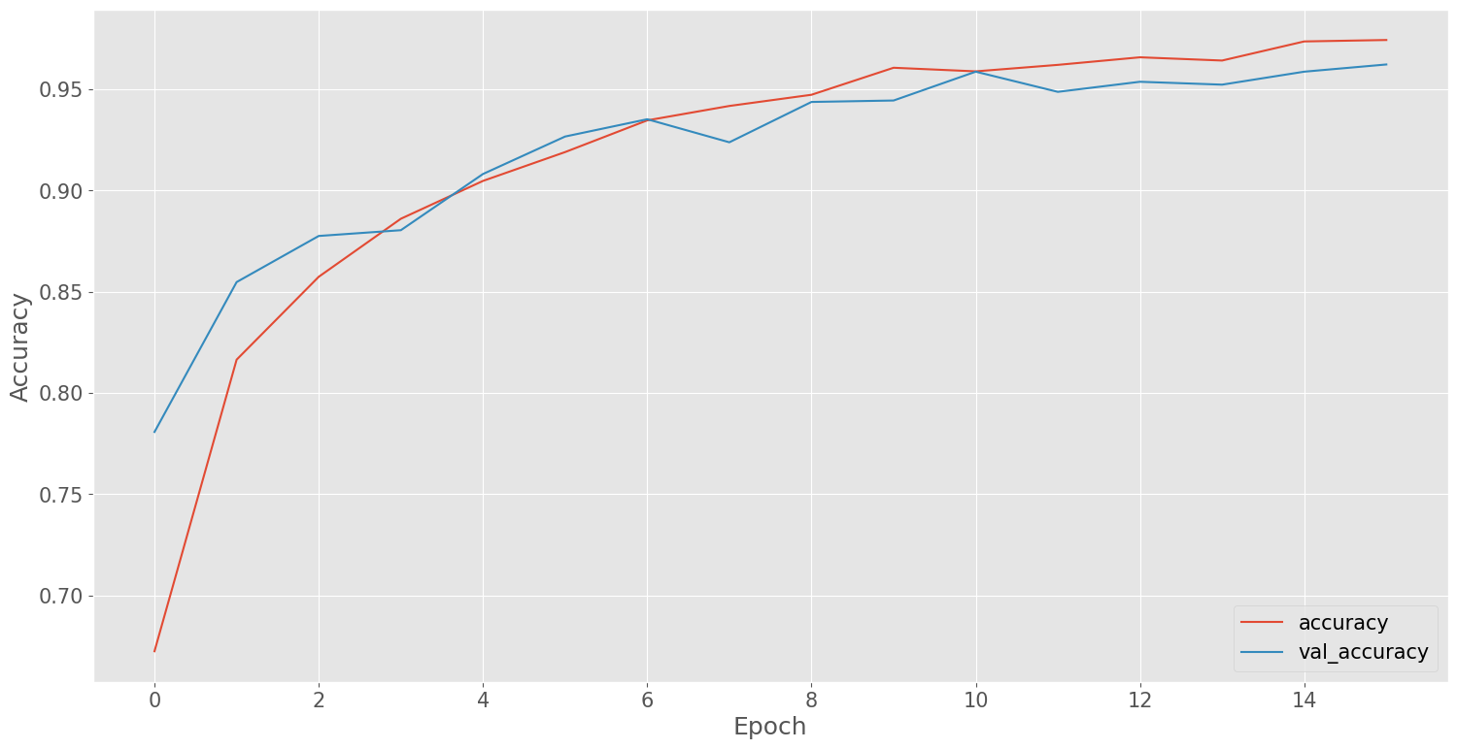
Results
Notes:
Now, let's discuss the results of our convolutional neural network model. The graph on this slide shows the training and validation accuracy over 15 epochs. We can see a steady improvement in accuracy for both the training and validation sets, indicating that the model is learning effectively without overfitting.
In terms of performance metrics, our model achieved a precision of 0.96 for gliomas, 0.90 for meningiomas, 0.98 for no tumors, and 0.97 for pituitary tumors. The recall rates were similarly high, with 0.93 for gliomas, 0.92 for meningiomas, 0.97 for no tumors, and 0.99 for pituitary tumors. The overall accuracy of the model was 0.95, with both macro and weighted averages of precision, recall, and F1-score also at 0.95. These results demonstrate that our model performs exceptionally well in identifying and classifying different types of brain tumors, providing a robust tool for early and accurate diagnosis.

Slide 13
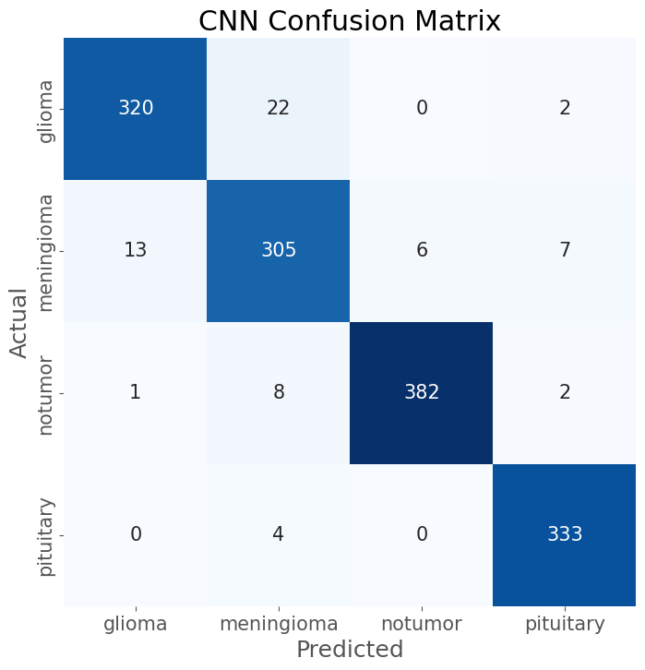
Confusion Matrix Analysis
Notes:
Next, let's take a closer look at the confusion matrix for our model's predictions. The confusion matrix provides a detailed breakdown of the model's performance by showing the number of correct and incorrect predictions for each class.
In this matrix, we can see that the model performs exceptionally well in identifying 'no tumor' cases, with 382 correct predictions out of 393. It also shows strong performance in classifying pituitary tumors, with 333 correct predictions out of 337. Additionally, the model accurately identifies glioma cases with 320 correct predictions out of 344 and meningioma cases with 305 correct predictions out of 331. However, there are some misclassifications, such as 22 glioma cases misclassified as meningioma and 13 meningioma cases misclassified as glioma.
Overall, the confusion matrix highlights the areas where our model excels and where there is room for improvement. This detailed insight is crucial for further refining the model and enhancing its diagnostic accuracy.

Slide 14
Recommendations for Implementation
Integrate into Clinical Practice
Regular Updates and Refinements
Collaboration and Dataset Expansion
User-Friendly Integration
Notes:
In conclusion, based on our analysis and the strong performance of the CNN model, we have several key recommendations for integrating this predictive model into clinical practice.
Firstly, healthcare providers, including doctors and radiologists, should deploy the model within electronic health record systems. This integration will assist in accurately identifying and localizing tumors from MRI scans. The benefits extend to insurance companies, as early detection and treatment can reduce long-term healthcare costs. Patients will also benefit from more timely and accurate diagnoses.
Regular updates and refinements to the model are crucial. This includes hyperparameter tuning, exploring advanced architectures such as 3D CNNs, and implementing transfer learning. These ongoing processes will improve the model's accuracy and reliability.
Collaboration with medical institutions is essential to access larger and more diverse datasets, which will further enhance the model's robustness. Developing user-friendly interfaces and ensuring compatibility with existing medical imaging systems will ease the model's integration into clinical workflows. Visualization tools can help medical professionals understand and trust the model's predictions.
By implementing these recommendations, the healthcare system can improve its capability to detect and treat brain tumors early, resulting in better patient outcomes and potentially increasing survival rates.

Slide 15

Future Work
Enhance Data Quality and Quantity
Ongoing Model Refinement
Clinical Integration
Regular Evaluation and Feedback
Notes:
For future work, based on our findings and the performance of the CNN model, we recommend several steps for practical implementation and further enhancement.
First, enhancing the quality and quantity of data is crucial. Acquiring more high-quality MRI images and ensuring a balanced representation of all tumor classes can significantly improve model training and performance. Collaborating with medical institutions to access larger and more diverse datasets will be beneficial.
Model refinement should be an ongoing process. This includes hyperparameter tuning, exploring advanced architectures such as 3D CNNs and ensemble methods, and implementing transfer learning to leverage pre-existing models for improved accuracy. Additionally, integrating the model into clinical workflows is essential. Developing user-friendly interfaces and ensuring compatibility with existing medical imaging systems will facilitate seamless integration. Visualization tools can help medical professionals understand and trust the model's predictions.
Regular evaluation of the model with new data and in real-world clinical settings is necessary to ensure its robustness and reliability. Feedback from healthcare professionals can guide further improvements. Furthermore, integrating the model with additional clinical data, such as patient demographics and medical history, can provide a more comprehensive diagnostic tool, enhancing predictive accuracy and treatment planning. By following these recommendations, we can enhance the model's effectiveness in real-world applications, ultimately contributing to better patient outcomes through early and accurate brain tumor detection.

Slide 16
Conclusion
Successful CNN Development
Effective Preprocessing
Training and Performance
Impact and Potential
Notes:
In conclusion, we successfully developed a convolutional neural network, or CNN, to detect and classify different types of brain tumors from MRI images. Our model focused on four categories: glioma, meningioma, pituitary tumors, and non-tumor images.
We started with effective preprocessing, normalizing image pixel values to ensure consistency and encoding tumor labels into numerical values. We split the dataset into training and testing sets to evaluate the model's performance on unseen data and applied data augmentation techniques to create a more diverse dataset, enhancing the model's generalization capability.
Our CNN model was trained over multiple epochs, learning to identify patterns associated with the four categories. We monitored the training process using an early stopping mechanism to prevent overfitting. The model achieved an impressive test accuracy of 94.95%, demonstrating its effectiveness in correctly identifying the presence and type of brain tumor.
The confusion matrix provided a detailed breakdown of the model's performance across different tumor types, showing high accuracy rates for gliomas, non-tumor images, and pituitary tumors. Although there were some misclassifications within the meningioma category, the overall results indicate a strong predictive capability. This model holds significant potential for aiding medical professionals in the early and accurate diagnosis of brain tumors, ultimately contributing to better patient outcomes through timely and targeted treatment interventions

Slide 17
Acknowledgements
Special thanks to Shmuel Naaman for mentoring and advising during this project
SpringBoard Data Science Program

